Slide 1
HR Dashboard_samira
File created on: 29/06/2025 08:42:56 GMT+2

Slide 2
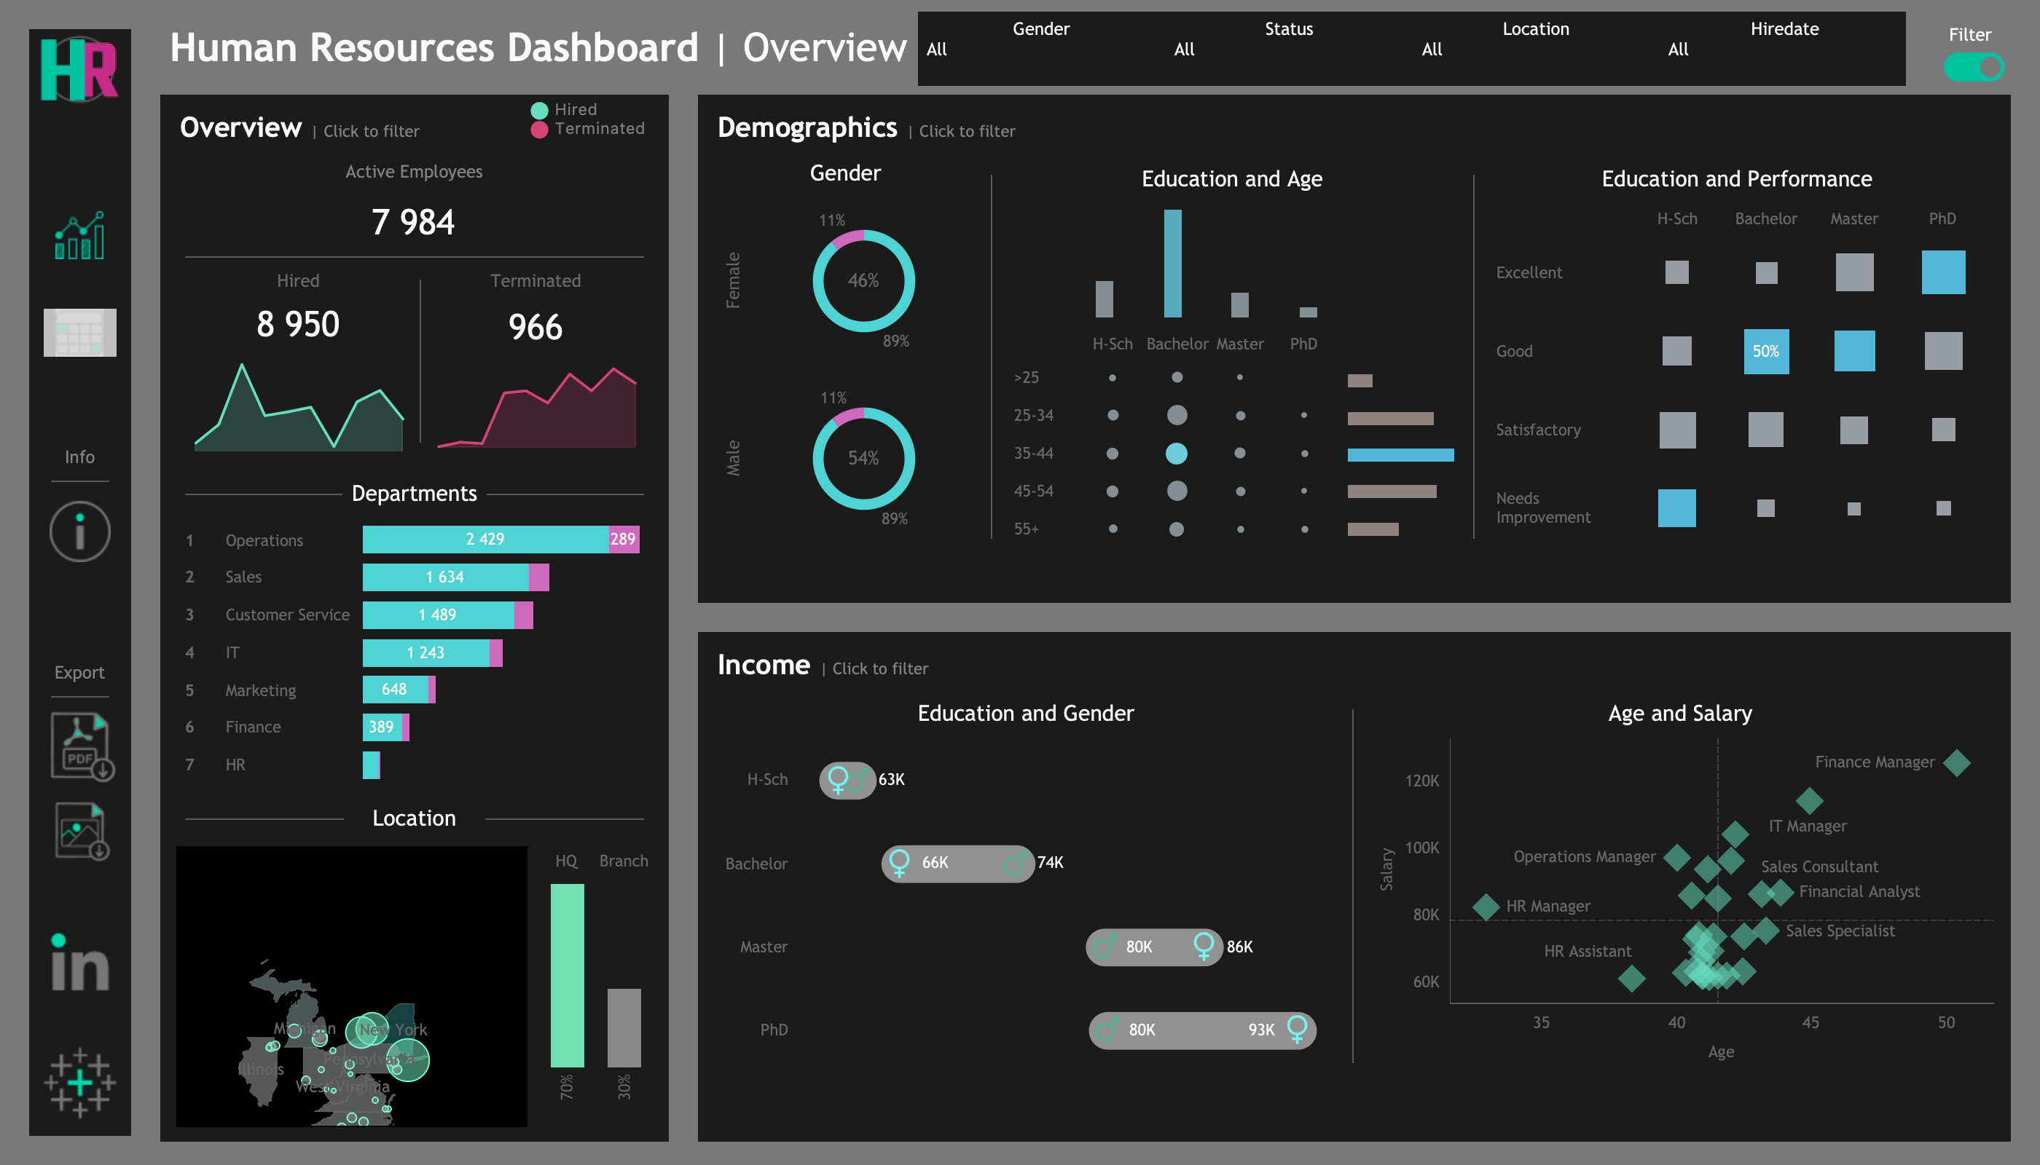

Slide 3
